Slide 1
CS 391 Final Project

Slide 2
Data Visualization Topic
Analysis of Bestselling Books
Why did I study it?
The revenue from the Book publishing industry has ranged between $25 billion and $26 billion since 2016¹
Why is it important?
Understanding trends through analyzing data of bestsellers will help make future decisions.
¹ https://publishers.org/news/book-publishing-revenues-flat-at-25-71-billion-for-the-year/

Slide 3
Design

Slide 4
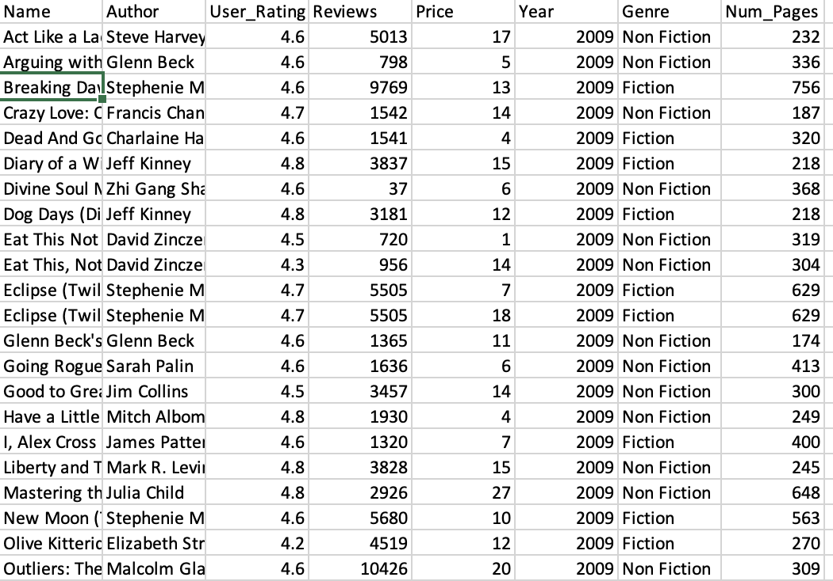
Dataset
Population Intended to Represent
Bestselling books

Slide 5
Preprocessing Dataset

Slide 6
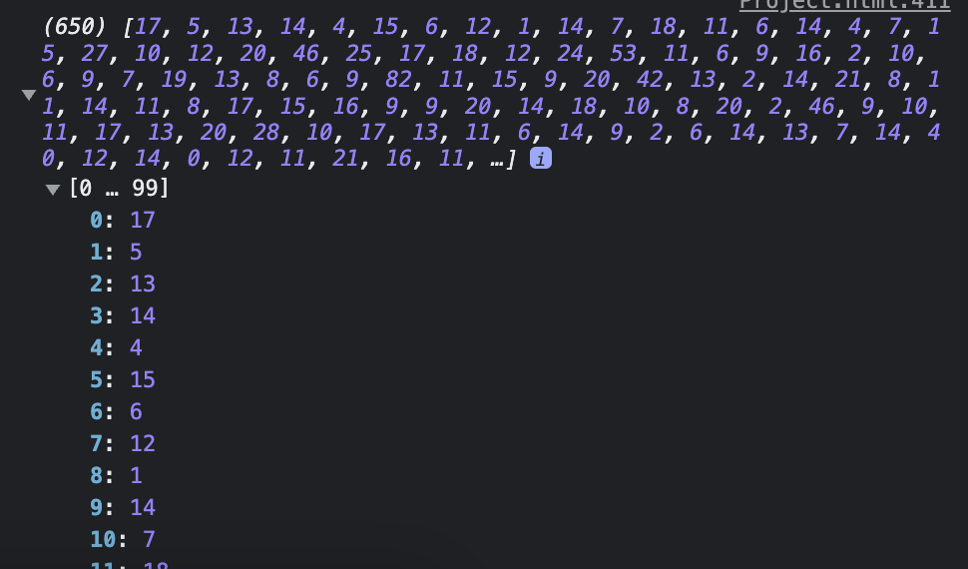
Histogram
All Prices

Slide 7
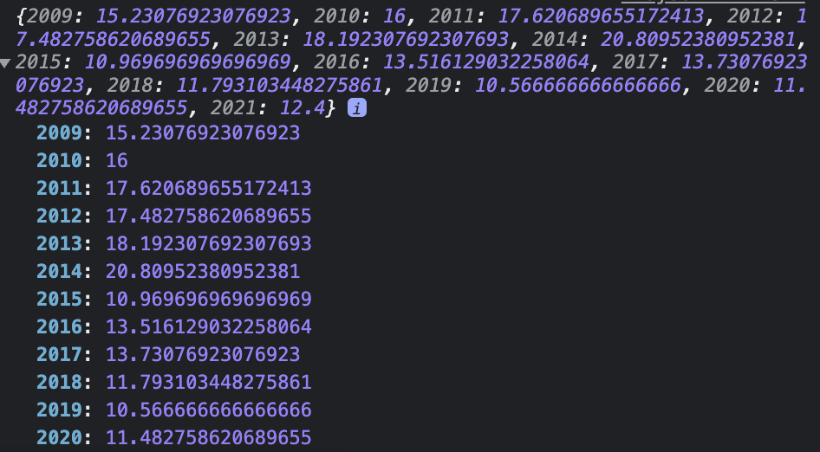
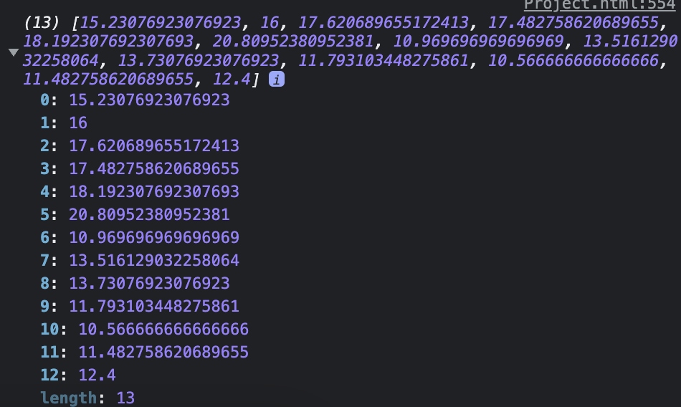
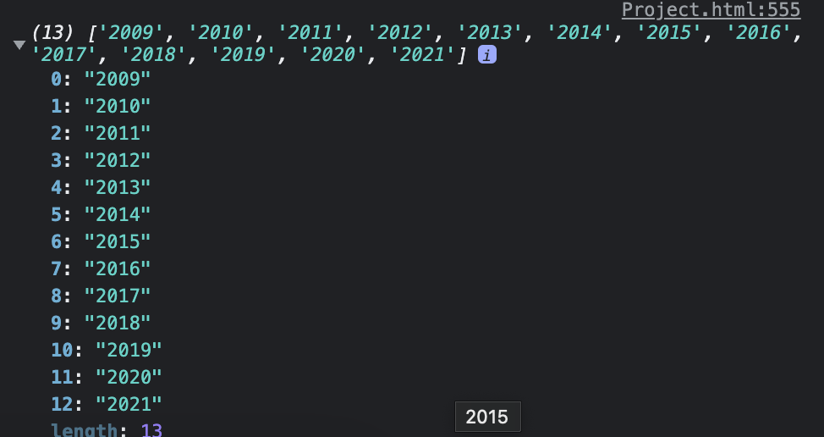
Line Chart

Slide 8
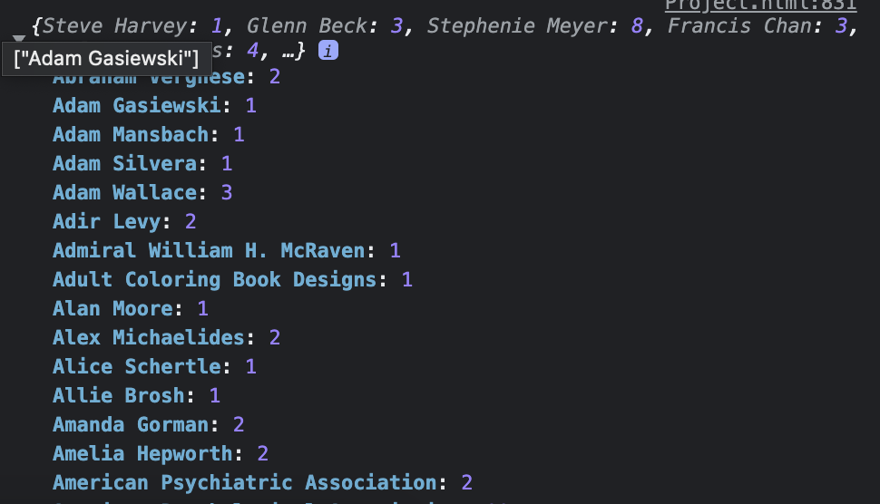
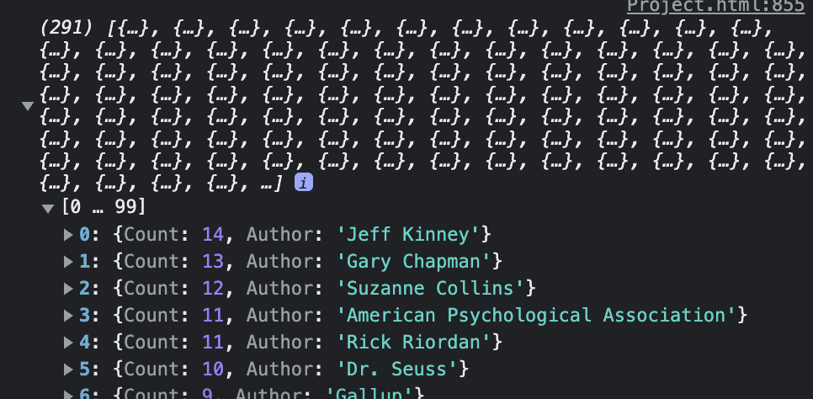
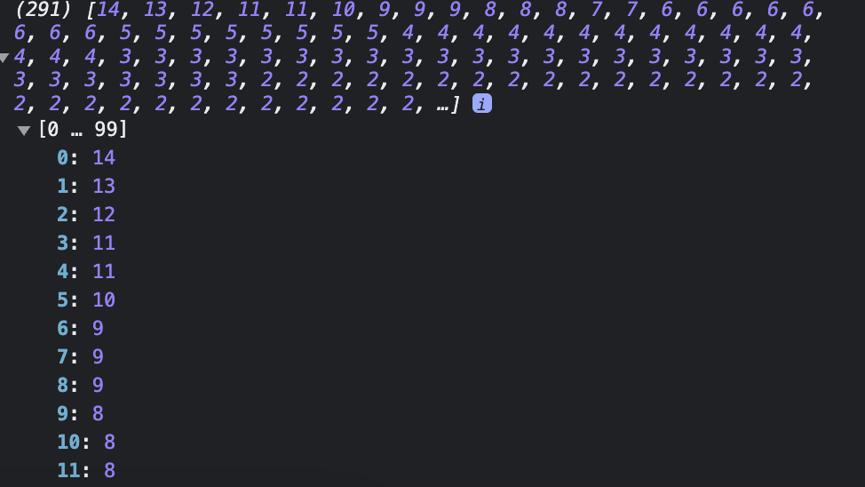
Pie Chart

Slide 9
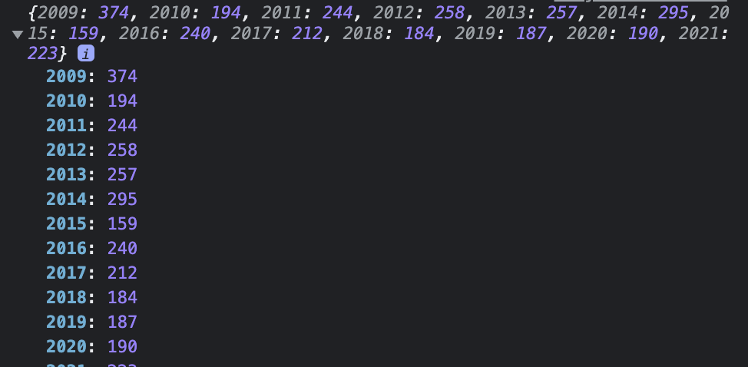
Stacked Bar Chart

Slide 10
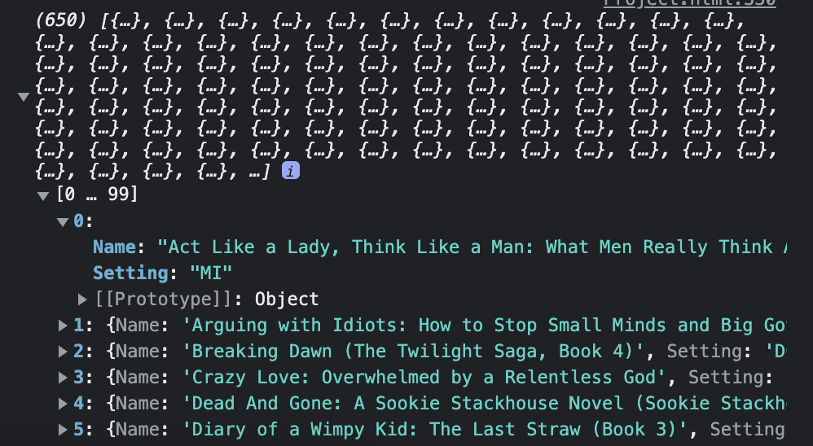
Geo Map – Creating Fake Dataset

Slide 11
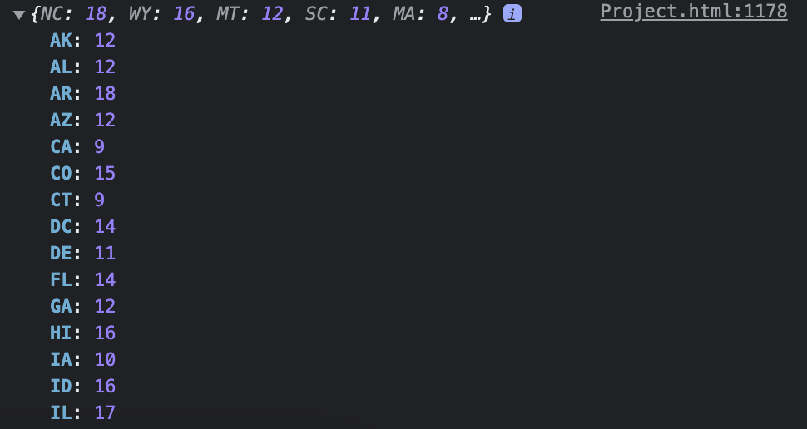
geoMap

Slide 12
Improvements
Modularized Naming Axes and Titles
Clear commenting
Future Ideas
Statistical Analysis (Easy to add due to separation of pre-processing to chart data processing)
Dynamic Design

